Slide 1
Kickstart your web map app!
FOSS4G 2016
Sami Mäkinen, NLS Finland
24.08.2016

Slide 2

Summer hit 2016
Pokémon GO
Location based game
Points of interest in real world
Interact with game when on/near point of interest

Slide 3
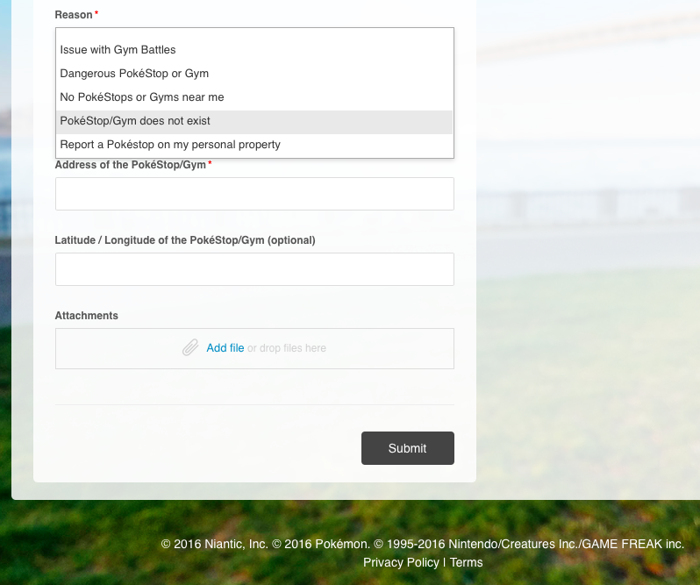

report an issue/request a point of interest

Slide 4
Oskari
Free open source platform for web map services (MIT/EUPL)
Java server – integrates to map services using OGC standards and allows extensions for proprietary formats
Extensible Javascript frontend - modules for building web apps

Slide 5




























OSKARI NETWORK

Slide 6
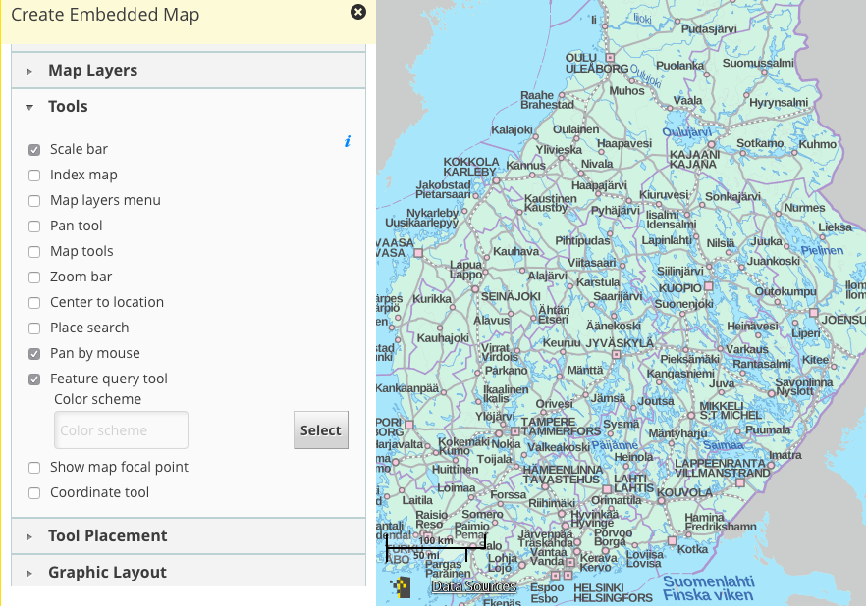
Publishing a MAP

Slide 7
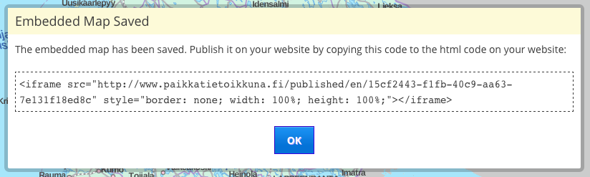
Publishing a MAP

Slide 8
InteractiON
Controlling the map/services
Move map
Make a search
Reacting to events on map
Map moved
Marker/feature on map clicked
Enhance map
Add features or markers
Draw on map
‘npm install oskari-rpc’
Vanilla/plain JS
Uses window.postMessage()
Communication restricted by domain

Slide 9
Connect to map
Include map HTML on page
Include JS-lib
Call OskariRPC.connect()
Wait for onReady()

Slide 10
Location
Events
MapClickedEvent
AfterMapMoveEvent
UserLocationEvent
Requests
MapMoveRequest
GetUserLocationRequest
Functions
getMapPosition()
getMapBbox()
getZoomRange () -> min, max, current
zoomIn(), zoomOut(), zoomTo()

Slide 11
Markers
Events
AfterAddMarkerEvent
MarkerClickEvent
Requests
MapModulePlugin.AddMarkerRequest
MapModulePlugin.RemoveMarkersRequest
MapModulePlugin.MarkerVisibilityRequest

Slide 12
Layers
Requests
ChangeMapLayerOpacityRequest
MapModulePlugin.MapLayerVisibilityRequest
MapModulePlugin.GetFeatureInfoRequest
Function
getAllLayers()

Slide 13
UI
Requests
InfoBox.ShowInfoBoxRequest
InfoBox.HideInfoBoxRequest
ShowProgressSpinnerRequest
Events
InfoBox.InfoBoxEvent
InfoboxActionEvent
Functions
setCursorStyle()
sendUIEvent()
getPixelMeasuresInScale()
getScreenshot()*

Slide 14
Drawing
Request
DrawTools.StartDrawingRequest
DrawTools.StopDrawingRequest
Event
DrawingEvent

Slide 15
Features
Requests
MapModulePlugin.AddFeaturesToMapRequest
MapModulePlugin.RemoveFeaturesFromMapRequest
MapModulePlugin.ZoomToFeaturesRequest
Events
FeatureEvent (add, remove, click)
Function
getFeatures()

Slide 16
And More
State handling: get, set, reset
Integrations
SearchRequest -> OpenStreetMap search by default, customizable
OpenTripPlanner -> getRoute() -> GeoJSON
Open311 -> feedback related functionality/
Extendable

Slide 17
Users of Oskari
European Location Framework Showcase App
Arctic SDI Geoportal
Finnish National eGovernment services
National Land Survey of Finland eServices
City of Tampere
The Regional Council of Southwest Finland
Statistical data service ”Liiteri” for the Finnish ministry of Environment
Finnish Transport Agency data download service
Permit Services for Municipalities (Lupapiste)
Unemployment Services Finland mol.fi
City of Helsinki beta map service
Iceland, launching later this year

Slide 18


Thank you! Questions?
http://oskari.org
nls-oskari
Oskari_org

